Slide 1

IBM Capstone Project
Krzysztof Podwórny 15 July 2019

Slide 2
Business Case
London is one of the largest cities in Europe - thousands of tourists visit this city every day. The first and obvious step in holiday-planning is - "Where we will stay" ? Then the real problem begins. Hundreds of places to sleep and hundreds of places to visit. Searching through the web might be inefficient as we would need to check tens of pages...
...and here is where we are coming with help

Slide 3
Problems & Resolution
We are here to recommend the best choice of stay in London, but how we are going to do it ? Couple of questions come into consideration
How do we find hotels ?
How do we grade them ?
From where we obtain the data
First, lets describe the data source:
All the data comes from Foursquare API - powerful application which contains geospatial data from all over the world. By using it, we will have access to all the hotel data in London as well as nearby venues which will help with recommendation process
Second - grading method:
We are going to assume that the best hotel would be the one, which has the highest online rating and has the most venues nearby. Having those 2 questions answered - we have the fundamentals to resolve that 'hotel issue in London'
The final form of the recommendation will be the list of 5 best hotels using the assumptions above - This will surely help the people coming here :)

Slide 4
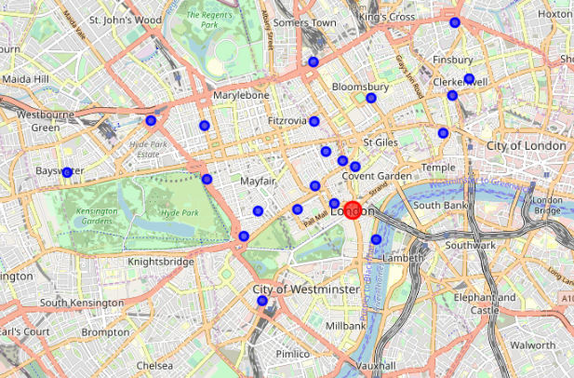
London Hotels
Using the Foursquare API we have managed to obtain the list of the hotels within 10km range of the city center. Next using Folium package we have visualized the data on a London map

Slide 5
Methodology
The whole project is about to find the best hotel. We have collected & cleaned & visualized data, now its the time for the next steps
As discussed, hotels are graded using their online rating and nearby venues, so now we will try to obtain rating using Foursquare API for all the hotels - we will loop through API database to get everything we need. Once completed it will allow us to point best 5 hotels
Once best hotels are pointed, we again use Foursquare API to find the venues in 1km range from the hotel - this is the second requirement for our decision process. When all data is in place, we are going to analyze the results on a map in terms of venues density. If this task would be difficult to process, then we will use k-means clustering method

Slide 6
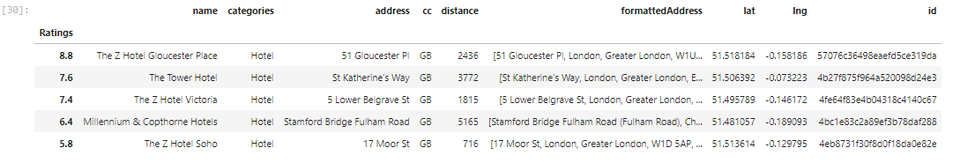
Data Analysis
First step in this section is to obtain ratings using Foursquare API. Using Hotel ID we are going to loop the database and fill the top 5 hotels with the ratings. Data then is being cleaned and organized

Slide 7
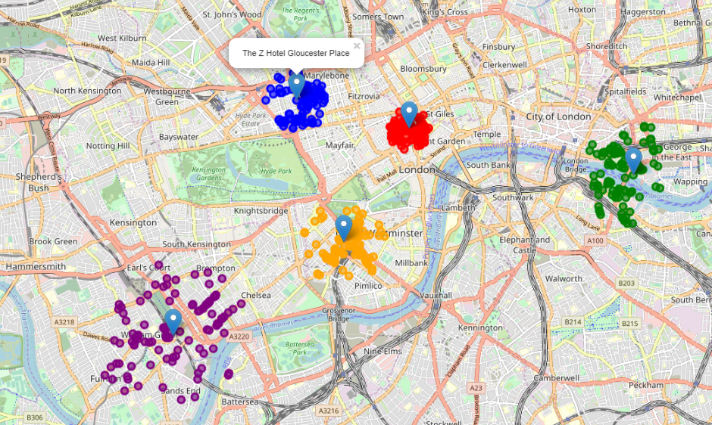
Results
Given the top 5 hotels names, we have looped through Foursquare API to find the venues nearby. Looking at this map we can see organized clusters, not overlapping each other. Blue, Red and Orange clusters are „Z” family hotels and have the most dense venue distribution. Given the fact that „The Z Hotel Gloucester Place”[blue cluster] belongs to this family and has the highest rating [8.8], then we can name this the best place to stay in London!

Slide 8
Discussion
This project has started from capturing the data about the hotels within the 10km range. Next using this data we have managed to obtain the ratings for them - this allowed us to select top 5 hotels within the range. As we know rating is not the only requirement for tourists, but a venues around. Given the hotel data we have managed to get the venues in a range of 1 km and succesfully visualized them on a map of London. When examining the map we can clearly see the biggest concentration of venues in the 'Z' family of hotels. The hotel with the highest rating overall is 'The Z Hotel Gloucester Place' - it does belong to the 'Z' family. Assuming that rating + venues concentration are 2 main requirements we can state that 'The Z Hotel Gloucester Place’ is the best place to stay in London.

Slide 9
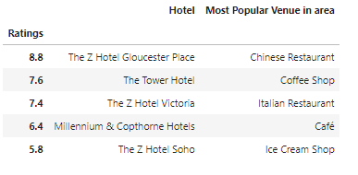
Conclusion
The purpose of this project was to help tourists to find the best place to stay - this is one of the most important factors when deciding about the trip. Preferences greatly differ for every individual, but there is one common value - "What is others opinion about this place" ? This has placed the fundamentals for this project, but we have gone 1 step ahead and tried to answer the second question "What i can do there once im placed in hotel" ? Combining these two charactersitics allows us to navigate to the best hotel in city - with highest rating and big concentration of venues nearby. We have made our choice in terms of which hotel is the best as per dataset, but we know that it still might not be the best for the person who is planning a trip. In order to satisfy the most people, we have created a small leaflet about the most popular venues around the top 5 places to stay - I'm sure this will be helpful to anyone going to London this year :)

Slide 10

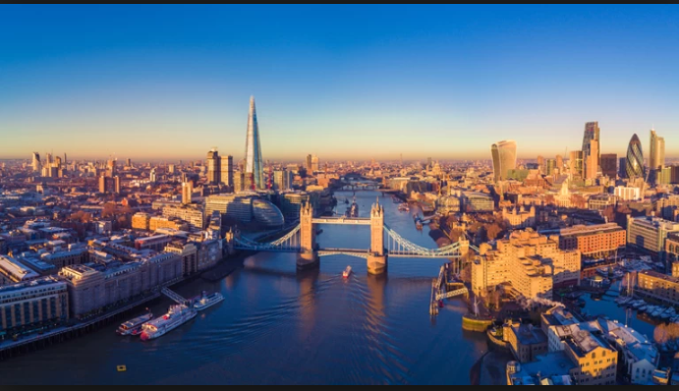
Thank you!

